Slide 1

GrubHub Recommendation Model

Slide 2
OUR MEMBERS
NUPUR KAWTRA
ISHITA GOYAL
SANSKRUTEE DUDHE
DEVVRAT KAUSHIK

Slide 3
Project Inroduction
Grubhub Inc is an American online and mobile prepared food ordering and delivery platform based in Chicago Illinois. Founded in 2004, it is a subsidiary of the Dutch company Just Eat Takeaway since 2021. Grubhub has been criticized for antitrust price manipulation, listing restaurants without permission, and allegedly misclassifying workers . Grubhub Seamless went public in April 2014 and was traded on the New York Stock Exchange under the ticker symbol GRUB as of 2019, it had 19.9 million active users, with 115,000 associated restaurants in 3,200 cities in all 50 US states

Slide 4
OBJECTIVES
Developing a recommendation model based on scraped data from Grubhub and make a webpage of it.
Design algorithms, analyzing user data to generate personalized recommendations based on past ratings, cuisine preferences, delivery review number and location.
Enabling users to access information about cuisine availability at different restaurants and preferred price ranges.
Develop user-friendly interface for feedback, enabling users to explore menus, reviews, and ratings of recommended restaurants.
Assisting potential restaurant owners in determining optimal cuisine offerings and average pricing for new restaurant ventures

Slide 5
Data stored as CSV
After extraction and processing, we saved the cleaned and structured data as CSV files for further analysis.
Visualization
Power BI was used to visualize patterns, and key insights derived from the restaurant data.
Data Extraction
We used Python, Beautiful Soup, and Selenium to scrape data
Insights Generation Through data analysis and visualization by Power BI, we generated actionable insights.
PROJECT
Data Cleaning
Cleaned, validated, and formatted the data, handling missing values.

Slide 6
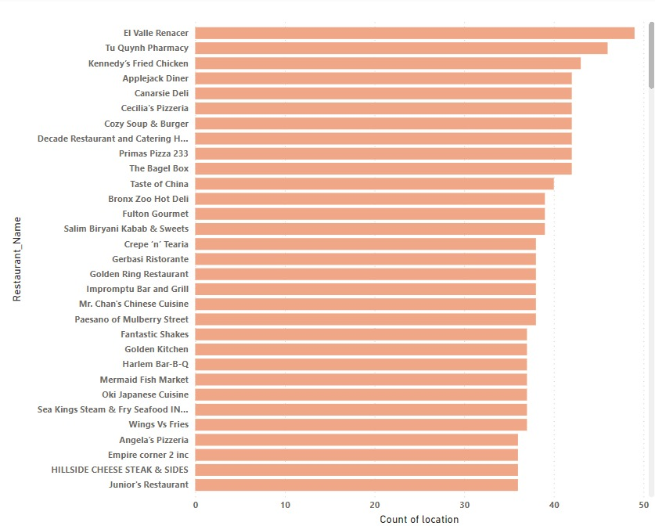
AREA WISE DISTRIBUTION OF RESTURANTS
EL VALLE RENACER RESTURANT STANDS FIRST

Slide 7
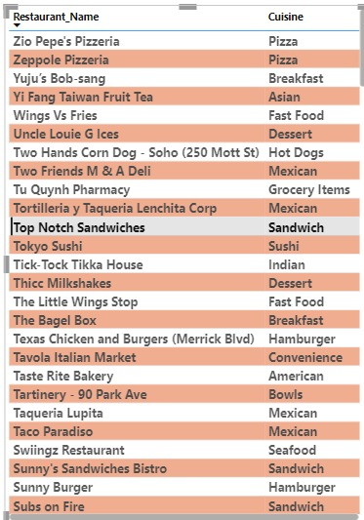
Most Cheapest Restaurants in New York city are extracted based on their Cuisine prices

Slide 8
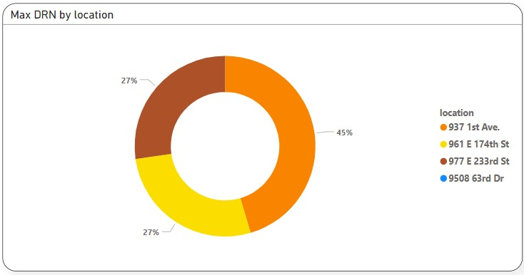
Top 3 Locations Having Most DRN of the Restaurants

Slide 9
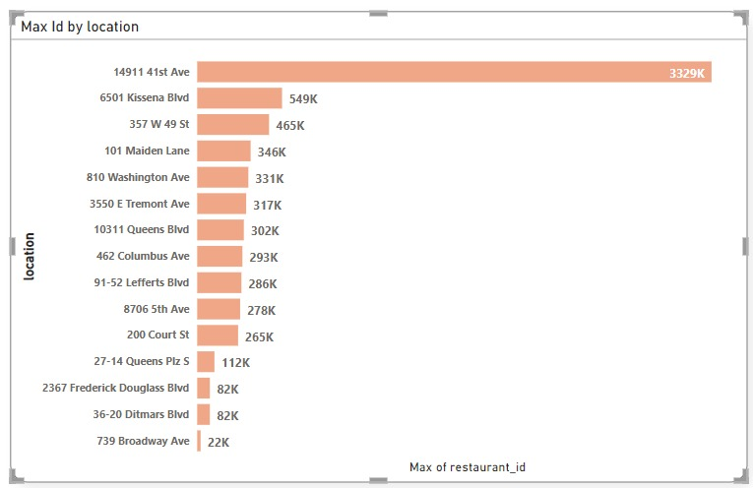
MAXIMUM RESTURANTS BY EACH LOCATIONS

Slide 10
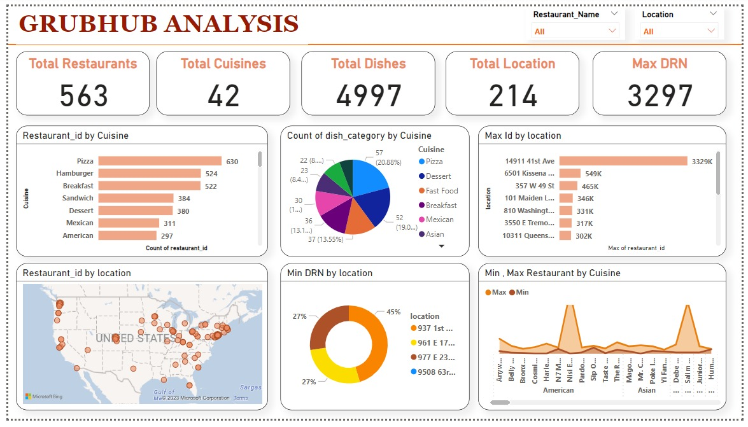

Slide 11
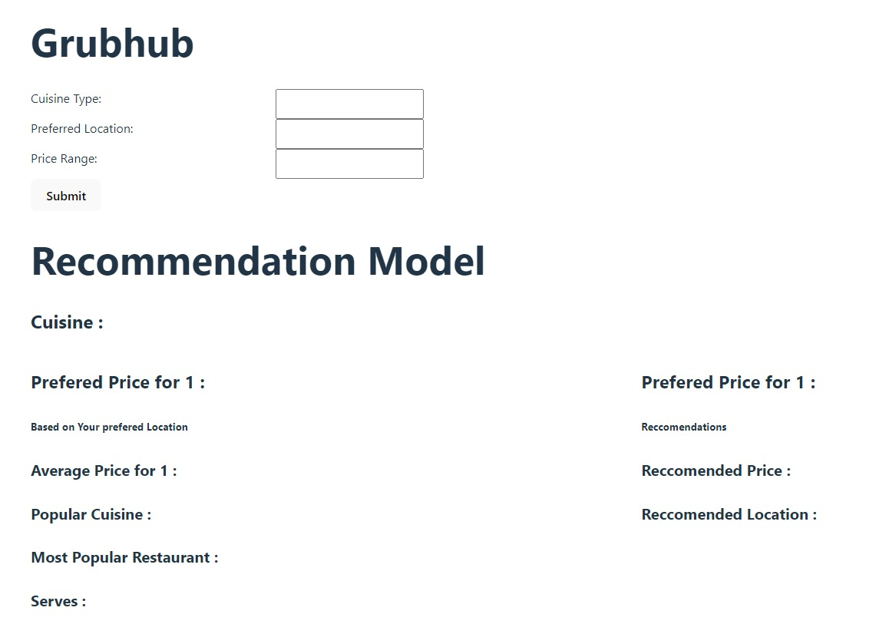
Grubhub Recommendation Model LINK - https://cuisinechase.vercel.app/

Slide 12
obstacles
Extracting data from web sources was a formidable endeavor that presents significant challenges..
Repetitive web source blocking incidents have arisen due to the omission of proper delay functions in our code..
Websites frequently update their structure and layout which breaks our scraping scripts

Slide 13
WHAT WE LEARNED
Web scrapping
python libraries like selenium and beautiful soup
Basic knowledge of html
Team work and coordination.

Slide 14
Thank YOU
We extend our gratitude to Masai for their project, which has provided us with invaluable insights into the significance of resources and real-world industry-level work

